Slide 1

Enhanced Spotify Recommender System
By: Aheli Chatterjee, Yican Wang, and Naman Jain

Slide 2
Project Overview
Goal: The goal is to improve the Spotify song recommender system using data analysis and interaction from the users
We built an enhanced Spotify song recommender system that uses methods like K-Means clustering and the IQR method to build the model
Our system collects feedback from users to update recommendations
Notes:
1. We explored the dataset using feature distributions and a correlation heatmap
2. To cleanup the data we removed outliers using the IQR method and we also applied the K-Means clustering method to group up songs that were similar.
3. User interaction is a very crucial component to our project. Users can input several different favorite songs of theirs to receive more personalized recommendations. The system also collects user feedback (like/dislike) to update the next round of recommendations. This makes the results more dynamic and accurate.

Slide 3
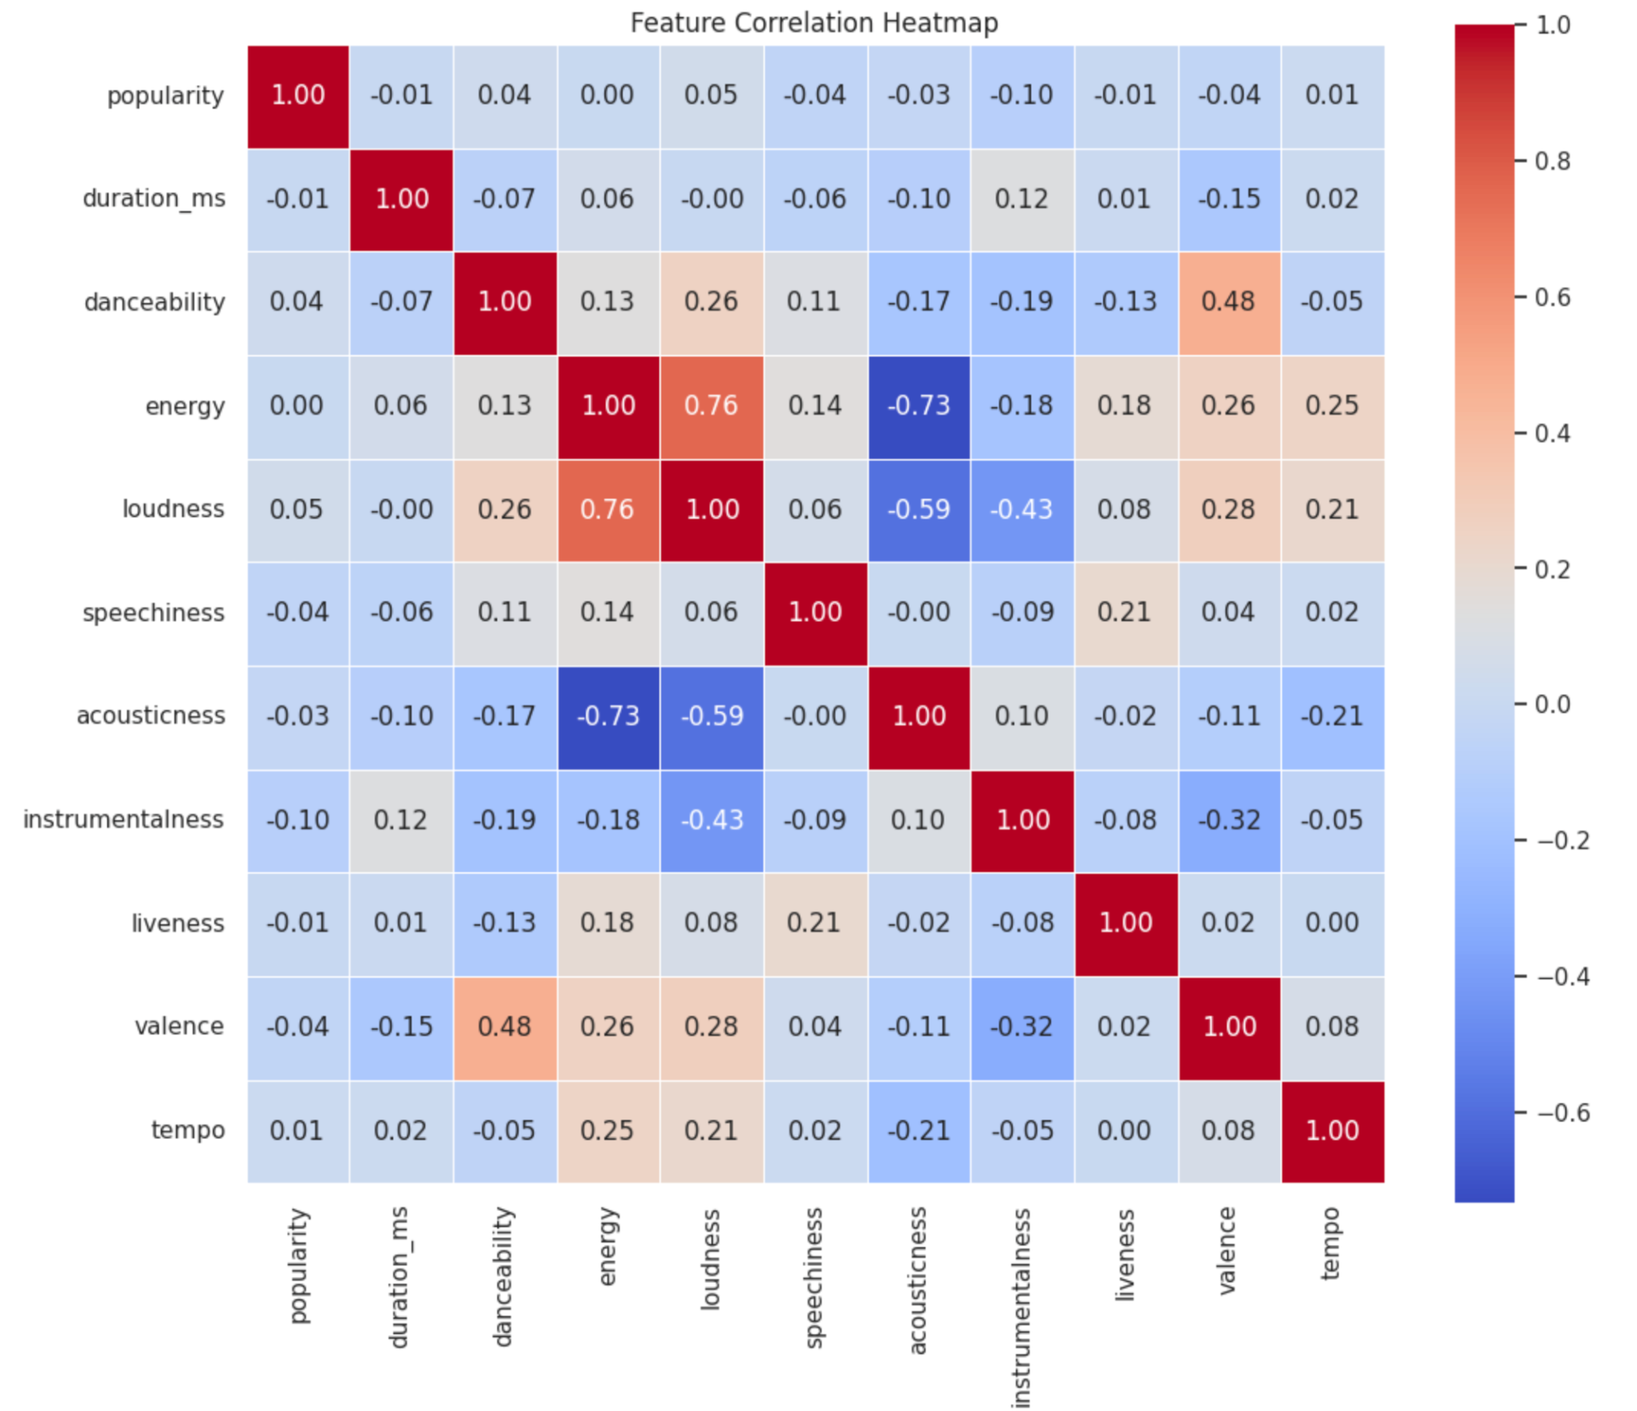
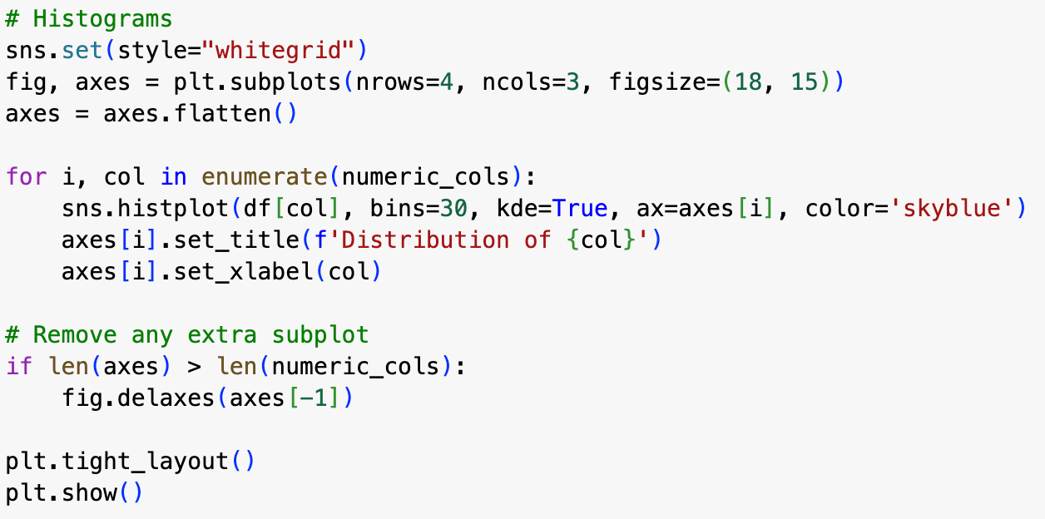
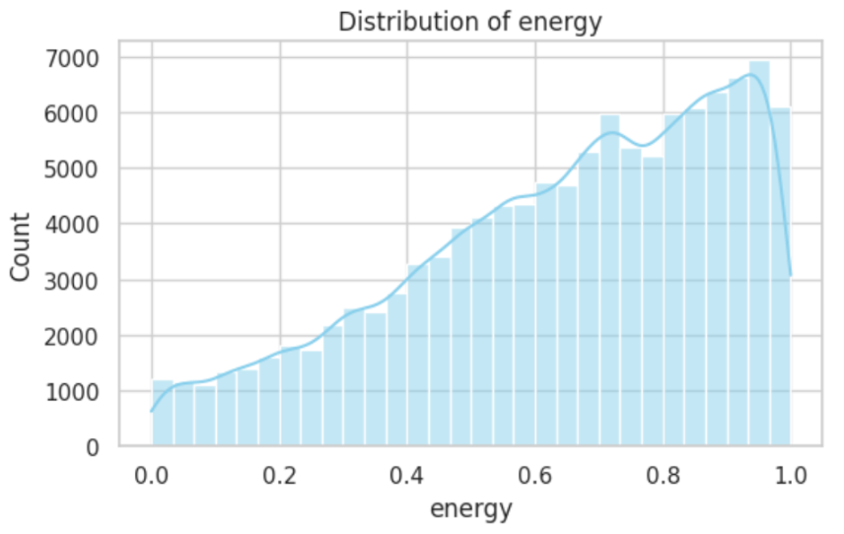
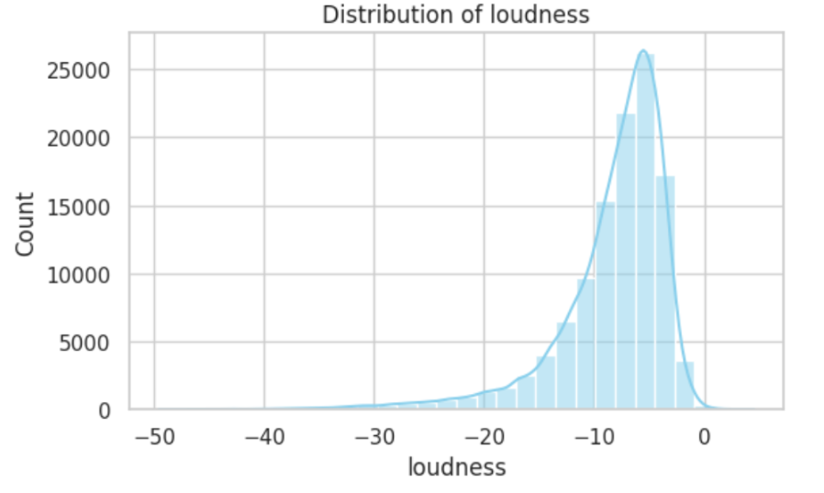
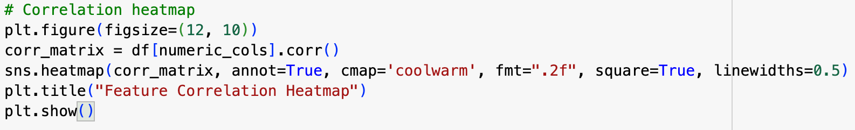
Data Exploration
We explored the Spotify dataset by visualizing key features
We used histograms and a correlation heatmap
These insights were useful in understanding how different audio characteristics are connected and helped inform our clustering step later on.
Notes:
These are features such as danceability, energy, valence, tempo, loudness, and popularity.
We used histograms to understand how these features were distributed, and a correlation heatmap to analyze the relationships between all the different features.
An example is that there is a strong positive correlation between the two features energy and loudness. (Louder songs tend to usually be more energetic). These are some of the insights that were useful in understanding how different audio characteristics are connected and helped inform our clustering step later on.

Slide 4
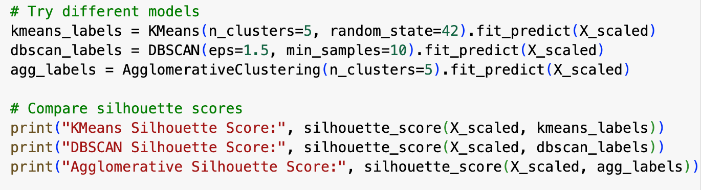
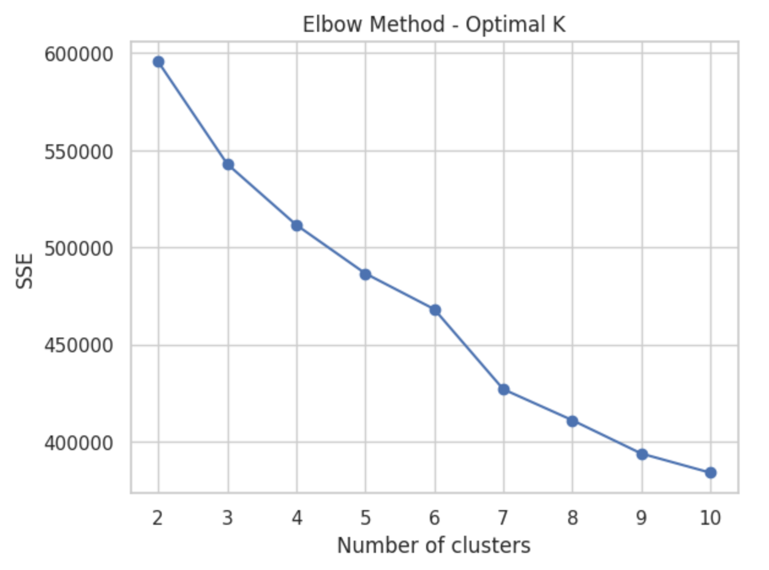
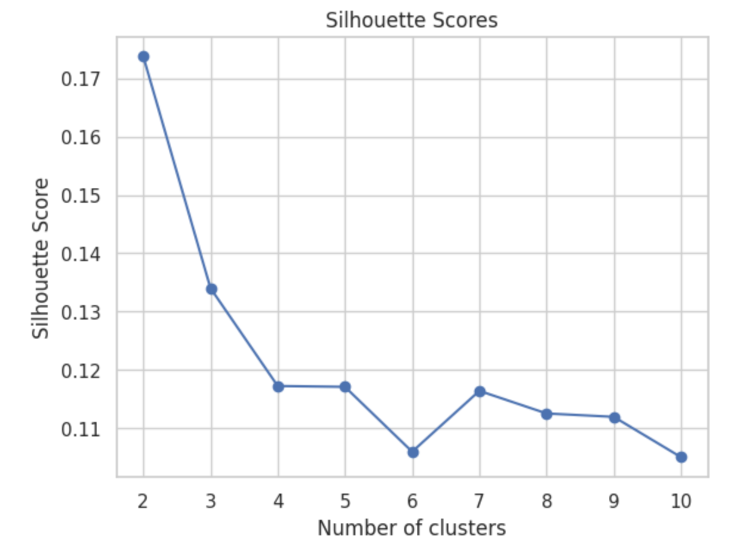
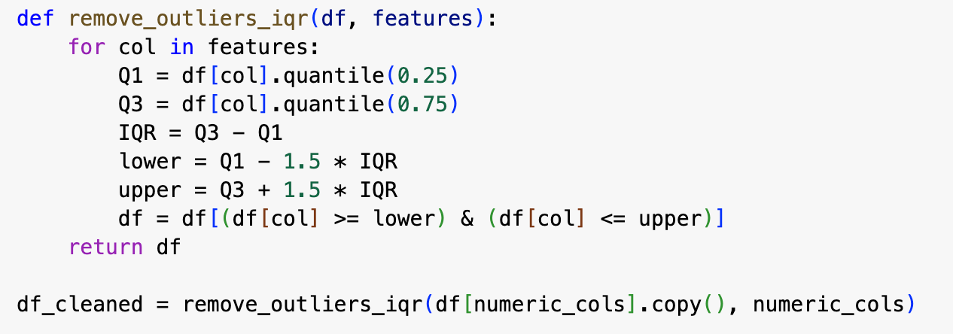

Outlier Removal and Clustering Modeling
To improve clustering accuracy, we first removed outliers using the IQR method.
Next we applied the K-Means algorithm for clustering and used the Elbow Method and Silhouette Score
We also tried DBSCAN and Agglomerative Clustering which helped us understand how songs group together based on their features.
Notes:
This method was implemented to improve clustering accuracy, and eliminate extreme values that can skew our results making them less accurate. Say for example a certain track length is extra long or the loudness of a song differs.
K-Means algorithm was applied for clustering, and the Elbow method/Silhouette score was used to decide the optimal number of clusters that would be best for our model
Those types of clustering allowed us to compare silhouette scores, and evaluate the clustering performance

Slide 5
Cluster Modeling and Evaluation
We tested three different clustering methods: K-Means, DBSCAN, and Agglomerative Clustering.
Using silhouette scores as a general reference, we compared their overall performance.
Based on the clarity and stability of the clustering results, we selected one method to use as the basis for our recommendation system which was the Elbow Method.

Slide 6
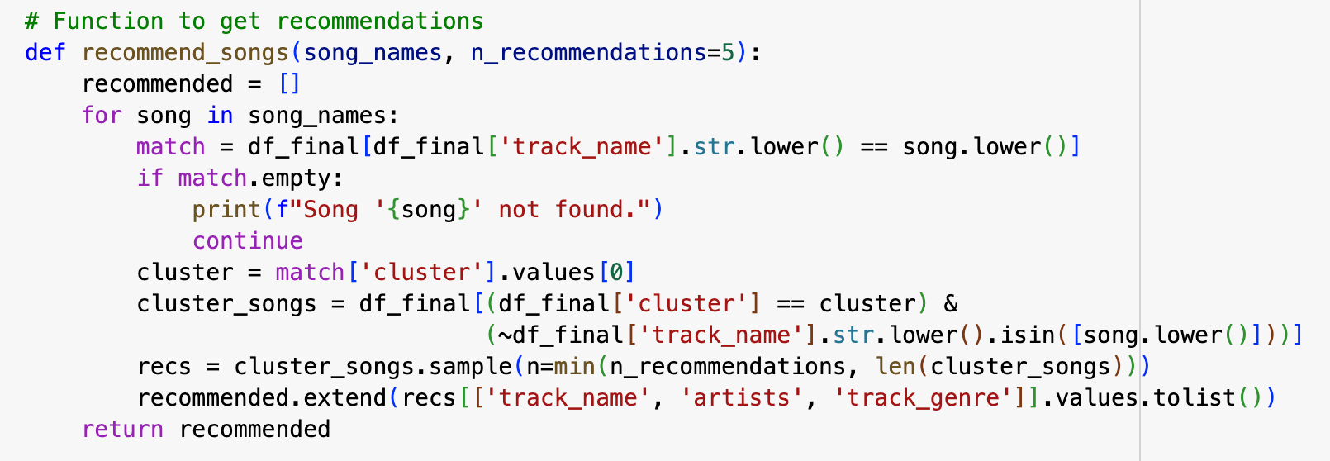
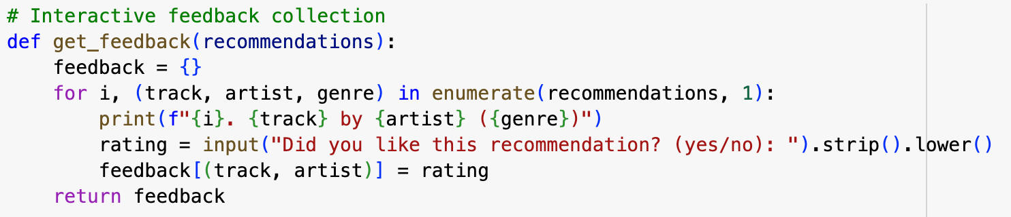
Recommendation System and User Feedback
We built a simple recommendation system based on the clustering results.
Users can enter their favorite songs, and the system recommends other similar songs from the same cluster.
After viewing the recommendations, users can give feedback by indicating whether they liked each song or did not like it
This feedback will be used to improve future recommendations by favoring songs from clusters the user prefers.

Slide 7
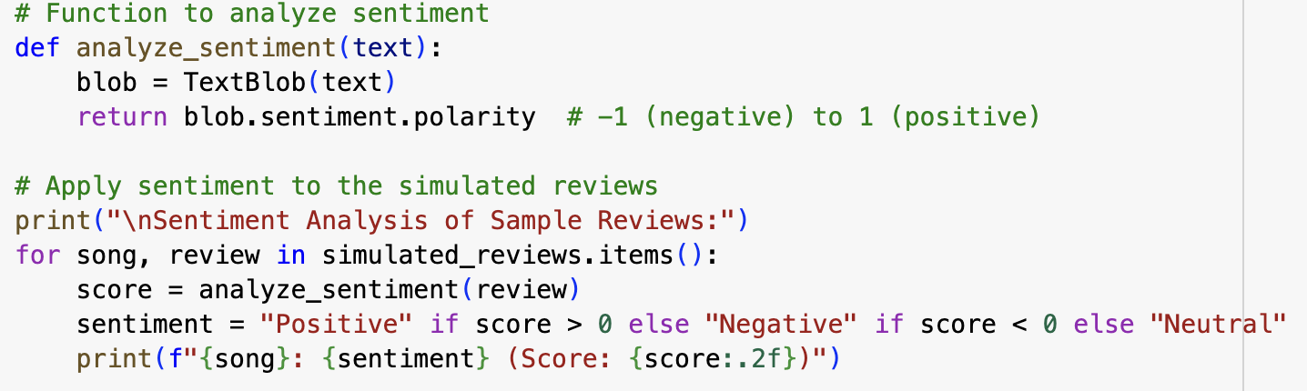
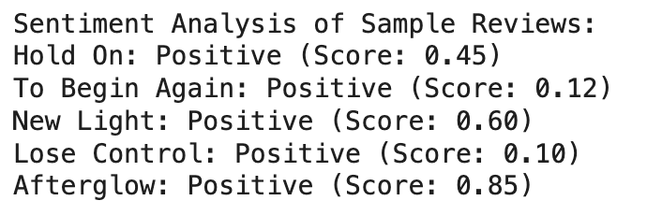
Innovation- Enhanced Model
Our enhanced model’s goal is to simulate reviews for the recommended songs
These simulated results help understand how popular the recommended song is based on the reviews themselves.
The reviews are scored to determine the popularity of the song
Notes:
Simulated reviews can have the description of the rhythm, melody, mood, lyrics etc of the song.
Then our model analyzes the simulated review and scores the song. If the review gets a score of less than 0 then the song is not as positive or popular either. If the score is more than 0 then the song is positive. The higher the score the more positive the song is and more likely it is to be recommended.
This will benefit our model and overall recommender since it will give us another piece of proof/evidence of whether a song is actually liked by a lot of people. The feedback in the simulated reviews can helps match up songs to the user and the clusters they usually listen too, giving more accurate recommendations.

Slide 8
Future Enhancements and Conclusion/Reflection
One enhancement that can be made in the future can be to check how many adds to a playlist a song gets.
The amount of streams a song gets can also determine if the song should be recommended
In this project, we explored a large Spotify dataset and used clustering techniques to analyze patterns in audio features.
We have implemented a basic level recommendation system that suggests similar songs to what a user prefers generally
Our added feedback mechanism and review mechanism allows for user input to improve our model
Overall this project helped us better understand how music features can be used to group and recommend songs.
Notes:
2. A song that is played often can be added to the clusters and gives a chance for more simulated reviews to be added. Overall it just helps with data collection
5. Our added feedback mechanism where users can like/dislike songs… continue on slide

